Slide 1



Working together in an Emergency
- to Keep North Westerners’ Safe
Strategic National Stockpile, Emergency Management, and Disaster Planning
Sonya L. Czerniak, MPH
Strategic National Stockpile Coordinator
Public Health Division
David H. Owens
Emergency Health & Medical Logistics

Slide 2
CDC Strategic National Stockpile
National repository of life-saving pharmaceuticals and medical supplies to protect the American public if there is a public health emergency severe enough to cause local supplies to run out.

Slide 3
SNS History
1999 Congress charged the HHS with creating a national pharmaceutical stockpile, the NPS was created within the CDC.
Provide within 12 hours of the decision to deploy
Deployments include:
  New York City on 9/11/01, two push packages.
  Anthrax 2001, managed inventory.
  Hurricane Katrina, 8/25/2005.
  Haiti earthquake, 1/12/2010.
  Numerous exercises with States.
Notes:
In 1999 Congress charged the Department of Health and Human Services (HHS) and the Centers for Disease Control and Prevention (CDC) with the establishment of the National Pharmaceutical Stockpile (NPS). The mission was to provide a re-supply of large quantities of essential medical materiel to states and communities during an emergency within twelve hours of the federal decision to deploy.
The Homeland Security Act of 2002 tasked the Department of Homeland Security (DHS) with defining the goals and performance requirements of the SNS Program, as well as managing the actual deployment of assets. Effective on 1 March 2003, the NPS became the Strategic National Stockpile (SNS) Program managed jointly by DHS and HHS. With the signing of the BioShield legislation, the SNS Program was returned to HHS for oversight and guidance. The SNS Program works with governmental and non-governmental partners to upgrade the nation’s public health capacity to respond to a national emergency.

Slide 4
SNS Structure
The SNS is organized for flexible response!
If the threat agent is unknown, the first line of support is the 12-hour Push Package.
If the threat agent is known, CDC officials can send Managed Inventory.
If a disaster calls for evacuation or Medical surge, the CDC can send Field Medical Stations.
Positioned strategically all over U.S.
Nerve agent exposure requires extremely rapid response, so CHEMPACK is forward deployed to states.
Notes:
The 130 air-cargo containers can fill a wide body jet or come over the road in eight 53-foot Tractor-trailer rigs. The new formulary increased the amount of 10-day unit-of-use antibiotic courses from 300,000 to 500,000. Eventually, the split between Doxycycline and Ciprofloxacin will be 50/50. Currently it is 80% doxycycline and 20% ciprofloxacin.

Slide 5
12-hour Push Package
Package contains – pharmaceuticals, medical supplies, antidotes (unknown event)
130 air cargo containers
50-tons
500,000 10-day courses of antibiotics
Airway supplies
IV supplies

Slide 6
Managed Inventory
98% of the SNS inventory
Can be tailored to the specific event agent
Includes
  Pharmaceuticals
  Hydration/IV fluids and supplies
  Medical/Surgical supplies
  Airway management supplies
  Personal Protective Equipment
  Repackaging Equipment and Ventilators
Notes:
Even though we have an understanding of what the SNS has on hand, everything is subject to change and the formulary will change as new threat agents emerge and new countermeasures are developed. Additionally, the CDC is able to provide additional medications and medical supplies through contracts with the Veterans Administration. CDC can use this mechanism during an emergency to rapidly procure additional materials that are not typically part of the SNS formulary.

Slide 7
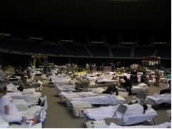
Field Medical Stations
A Federal Medical Station (FMS) is a Department of Health and Human Services (DHHS)/Assistant Secretary for Preparedness and Response (ASPR) deployable asset. The Division of Strategic National Stockpile is responsible for the deployment of FMS when directed by DHHS.
250 bed station in 50 bed increments
State/Local/Tribal responsibilities to provide:
  40,000 square foot ADA compliant facility
  Power, water, waste pickup, rest rooms, showers, etc.
Notes:
Currently, each FMS is configured in three modules:
Base Support – Five 50 bed sets with bedding, personal hygiene, personal protective equipment and supplies for administrative, food, housekeeping, first aid, basic medical, pediatric and bariatric services
Treatment – Supplies for medical, surgical, chronic care, special needs and non-acute care
Pharmacy – Prescription medications and pharmaceutical supplies
Requires a minimum of 40,000 square feet of enclosed, climate controlled space
Is scalable to the needs of an incident
Has modular configuration as treatment and pharmacy modules can be easily added to the base module to enhance unit capability
Can be transported by air, water or ground
Can be quickly integrated into pre-selected sites
Can care for non-acute, special need or quarantined patients for up to three days
Is modeled to accommodate all age populations

Slide 8
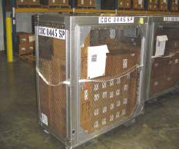
CHEMPACK
The mission of the CHEMPACK Program is to forward place a sustainable resource of nerve agent antidotes throughout the United States, where it will be rapidly available to state and local emergency responders and enhance their capability to respond quickly to a large-scale nerve agent exposure.
States deploy these resources strategically to population centers of greatest vulnerability.

Slide 9
When and Why
Disaster will require rapid access to large quantities of resources
County and states do not have the required resources
National stockpile created as a resource for all

Slide 10
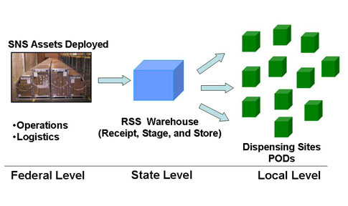

Slide 11
CRI
The Cities Readiness Initiative (CRI) is a federal effort designed to increase bioterrorism preparedness in the nation's larger cities.
  Increase bioterrorism preparedness
  Save Lives; medicine into entire population within 48 hours
  72 Metropolitan statistical areas (MSAs) across the U.S. included
Notes:
The Cities Readiness Initiative (CRI) is a federal effort designed to increase bioterrorism preparedness in the nation's larger cities. The goal is to save lives in these selected cities by rapidly dispensing medication to their entire population within 48 hours of the decision to do so.
Since 2004, CDC has provided special funding for CRI through the Public Health Emergency Preparedness Cooperative Agreement. The funding is provided to enhance the mass dispensing capabilities of the CRI MSA's and their metropolitan statistical areas (MSAs) (Excel, 58kMB) [Accessible Version (PDF, 146k)]. 72 MSAs will use this special funding to develop plans that support mass dispensing of drugs to 100% of the identified population within 48 hours of a decision to do so. A total of 72 cities are included in this initiative.

Slide 12
Oregon & Washington Natural Hazards
Earthquake
Landslides
Volcanic Eruptions
Windstorms
Winter weather
Tornadoes
Tsunamis
Floods

Slide 13
Not so natural… Threats
Chemical
Biological
Radiological
Nuclear blast
Explosive
Notes:
CBRNE

Slide 14
Pandemic Influenza…
flu.oregon.gov

Slide 15
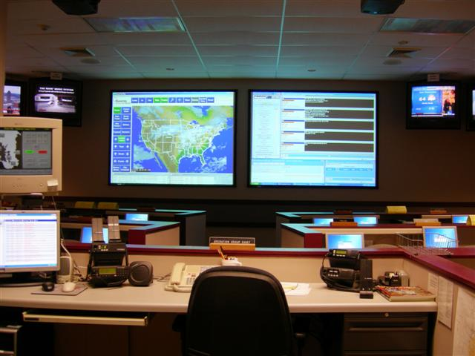
Emergency Response
Agency Operations Center
24/7
Activated in September
63 of the 72 days
Good deodorant
Notes:
NOTE: Could add photo of WA EOC. (Isn’t this the CDC DEOC?)

Slide 16
Requests for assets
Market supply of pandemic flu assets
Tamiflu suspension
N95 masks
Ventilators
Associated medications

Slide 17

Lessons Learned
Stand down
After Action Reports
CDC TAR
Rewriting plans
Cross border agreements
Warehouse selection

Slide 18
Employment…
GIS
Statistician
Public Health
Lawyer
Information Technology
Medical Degree
Law Enforcement
Business
Veterinarian
Epidemiologist

Slide 19
Ferret Talking Points
Believe in yourself
Take healthy risks
Trust your instincts
Go for it!

Slide 20
Thank you!
sonya.l.czerniak@state.or.us
(971) 673-0327
david.owens@doh.wa.gov
(360) 236-4417

